Slide 1
Project
Call Centre Dashboard
Description :- Understand the data of Call Centre and visualize by the Chart .In this dashboard we observe the rate of total calls ,how much call Answered by the employees etc. This data is real time data which convert into graphs and chart form to easy to understandable.

Slide 2
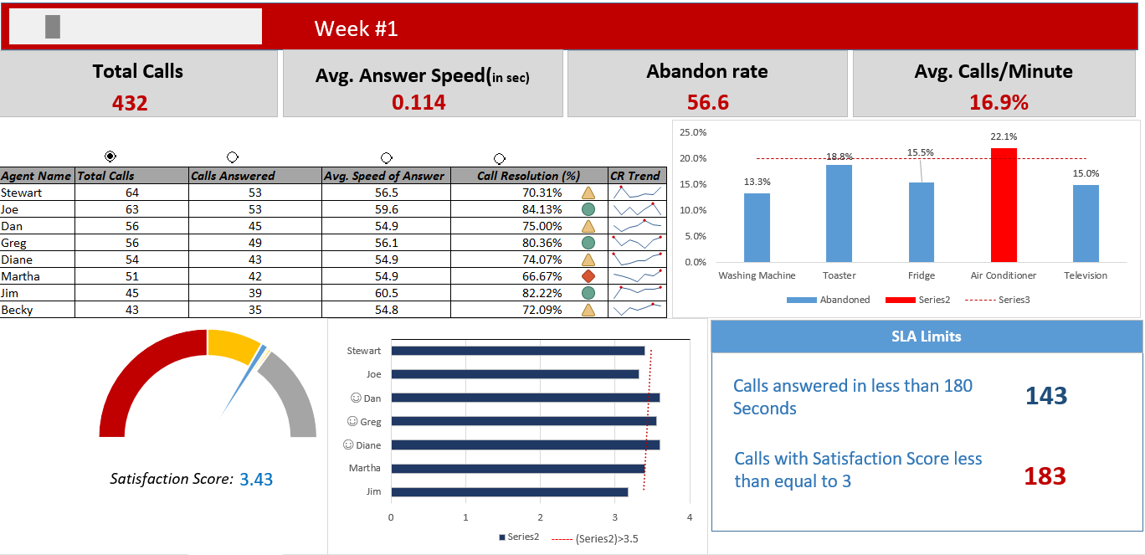
Overview :-

Slide 3
Insights 1:-Agent work done per Week
Agent Name | Total Calls | Calls Answered | Avg. Speed of Answer | Call Resolution (%) |  | CR Trend
Stewart | 64 | 53 | 56.5 | 70.31% | ###
Joe | 63 | 53 | 59.6 | 84.13% | ###
Dan | 56 | 45 | 54.9 | 75.00% | ###
Greg | 56 | 49 | 56.1 | 80.36% | ###
Diane | 54 | 43 | 54.9 | 74.07% | ###
Martha | 51 | 42 | 54.9 | 66.67% | ###
Jim | 45 | 39 | 60.5 | 82.22% | ###
Becky | 43 | 35 | 54.8 | 72.09% | ###

Slide 4
Insights 2:-Product abandoned rate

Slide 5
Insights 3:-No. of call answered by employees

Slide 6
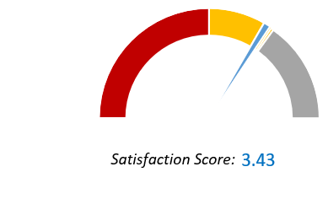
Insights 4:-Satisfaction score by customer

Slide 7
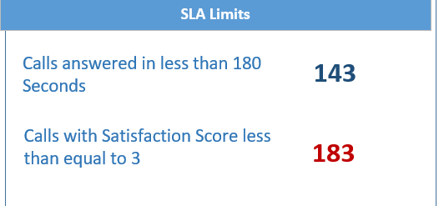
Insights 5:- SLA Limits

Slide 8
THANK YOU

